Slide 1
Experiment-4

Slide 2
Docker

Slide 3


Prepared By
Bhuvnesh Sanathra
Semester-7

Slide 4
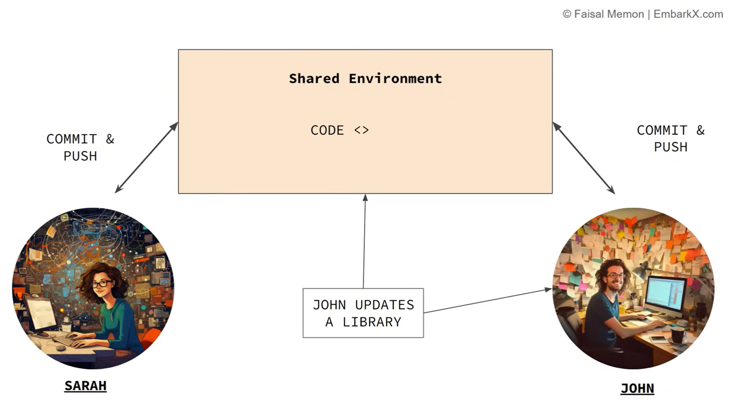
Why Docker?
2 Person are working on same code base and let say JOHN changes the Version of library used in shared Environment.
Now, it is difficult to manage the version of different user in same shared environment.

Slide 5
Why Docker?
It causes version conflict or compatibility problem.
Which then causes the inconsistency in development.
Application is working fine in one development environment but not in another developer environment.

Slide 6
What is solution to this??
Docker
HOW??

Slide 7
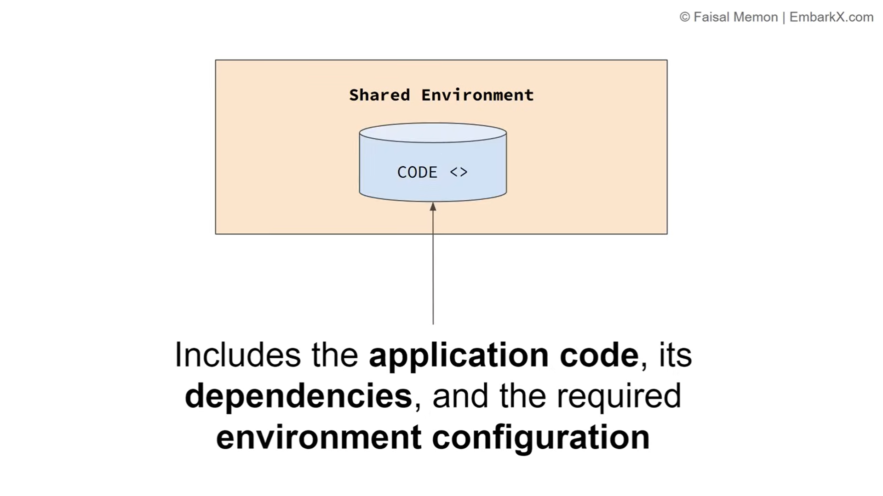
How?
Containerized the application using Docker.

Slide 8
What does it means?
Move codebase to container.
Which includes application code, dependencies, and the required environment configuration.

Slide 9
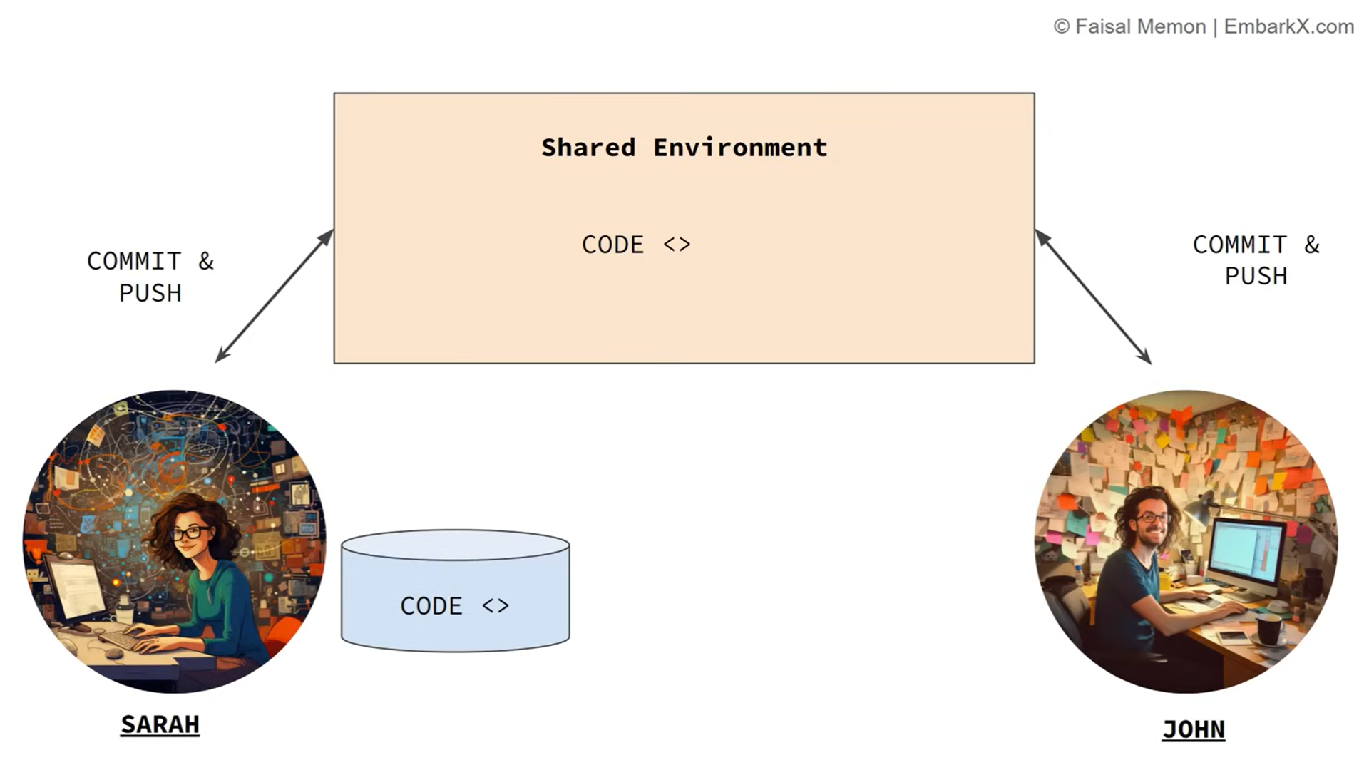
How?
SARAH will use the Docker and has the container which contains all the required environment and application is running.

Slide 10
How?
Now SARAH no need to worry about the conflicting versions or any other issues because of any versions conflicts.
Now everybody in team of SARAH will upgrade to Docker.

Slide 11
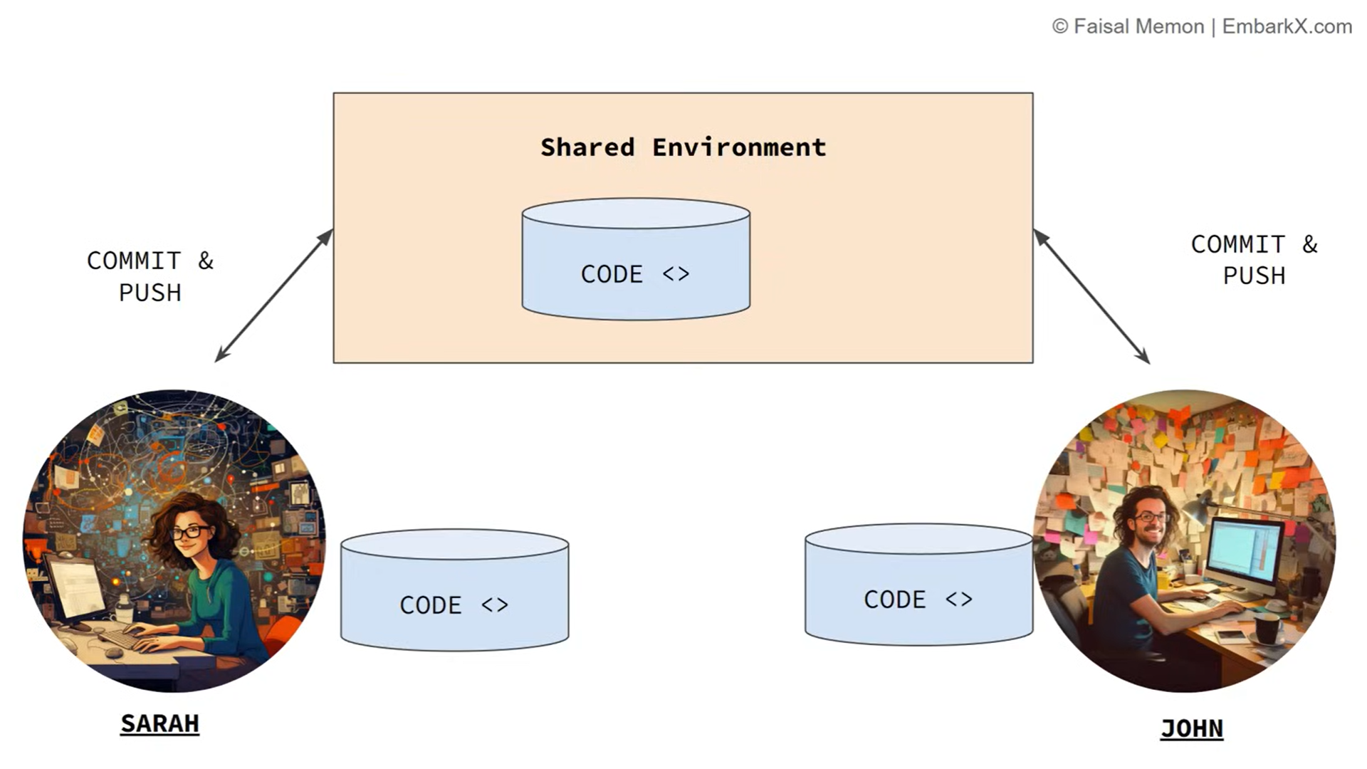
How?
Now, isolated container Is shared between the team and this container has all the required item to run the application.

Slide 12
What Docker solves?
Dependency Management.
Compatibility issues.
Environmental inconsistency.

Slide 13
What is Docker?
Docker is an open-source platform that allows you to automate the deployment, scaling and management of applications using containerization.

Slide 14
What is Containerization?
lightweight virtualization technology
package an application along with its dependencies that is needed for an application to run

Slide 15
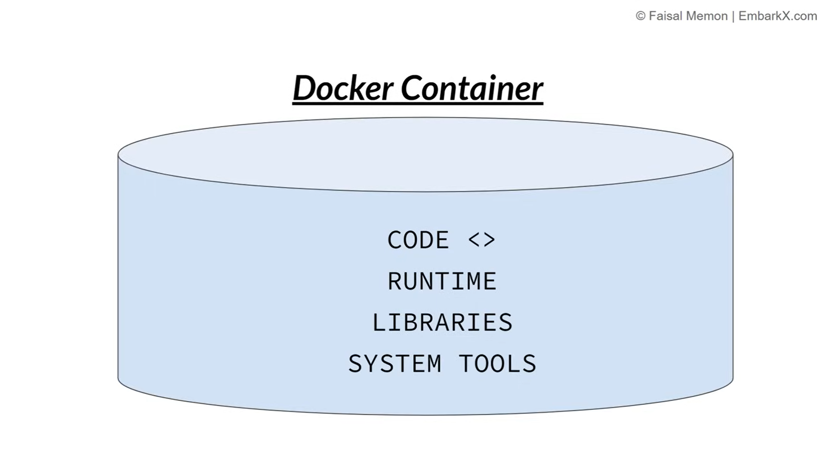
Docker Container

Slide 16
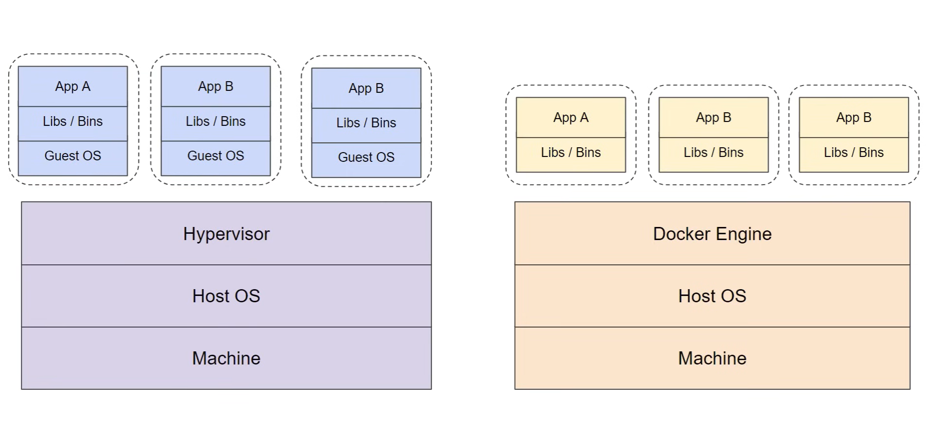
Docker over VM’s

Slide 17
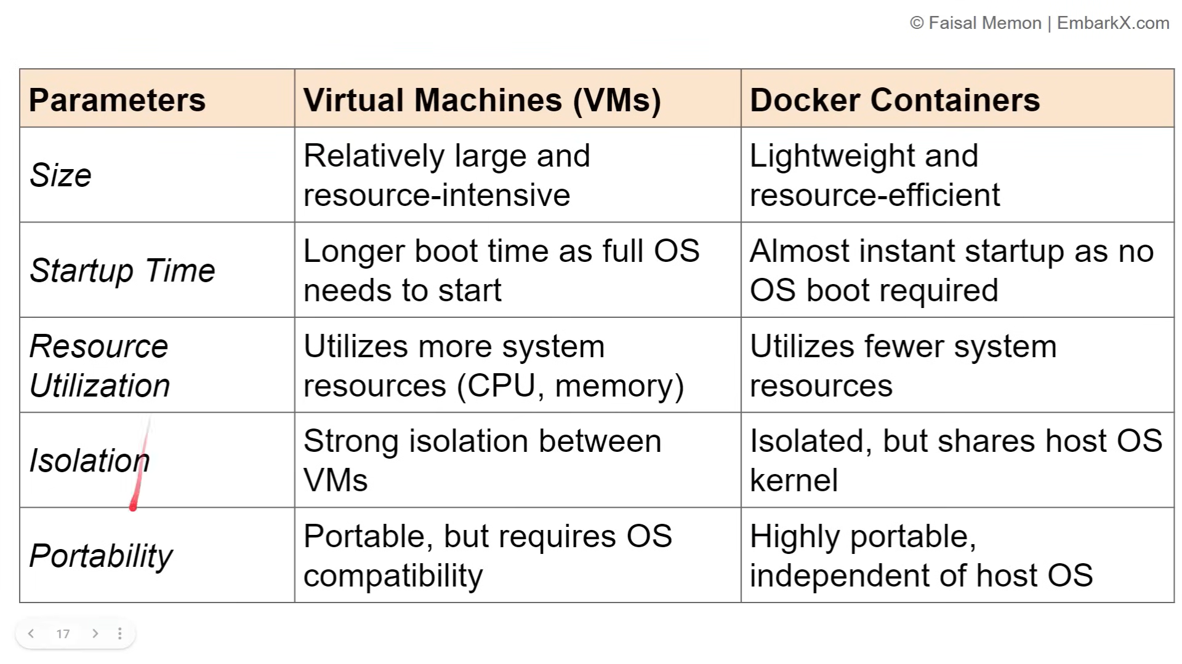
Docker over VM’s

Slide 18
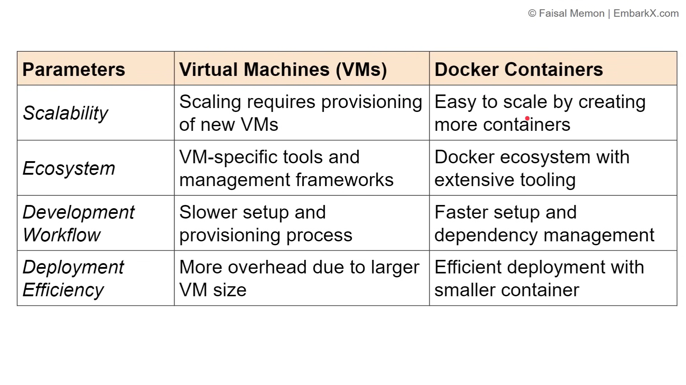
Docker over VM’s

Slide 19
Docker Architecture

Slide 20
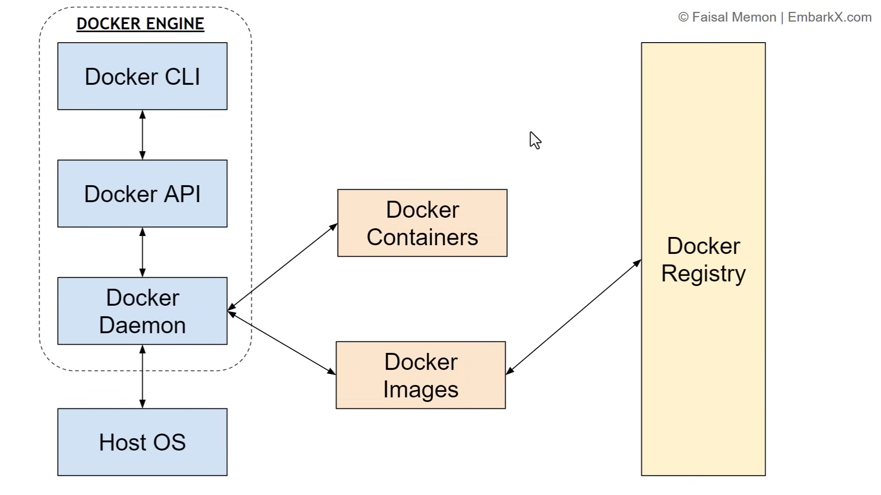

Slide 21
Docker Engine
It contains:
1. Docker CLI
2. Docker API
3. Docker Daemon

Slide 22
Docker Engine
Docker CLI
It’s a client that allows users to interact with Docker
It is used to communicate with the Docker.
It will interact with Docker Daemon.

Slide 23
Docker Engine
Docker Daemon
Runs on Host OS.
Responsible for building docker images & managing containers.

Slide 24
Docker Images
Blueprint for creating a container.
From one image we can create multiple image.
Templates that define the container and dependencies
Image are base on which container is build.

Slide 25
Docker Containers
Light weight
Running instance of Docker image.
Dockerfile
Instruction to build a Docker Image.
Docker Hub
Registry that has the vast collection of Docker images.

Slide 26
Docker Registry
It stores docker images.
Images can be public or private.
Repo of all the images.

Slide 27
Docker Registry

Slide 28
Docker Registry
Store docker images with different version.
Importance of Docker Registry
Centralized Resource.
Easy Versioning.
Share your Docker Image.

Slide 29
Available Docker Registry
https://hub.docker.com
Default registry used by Docker CLI and most of the docker tool.
https://aws.amazon.com/ecr/
https://cloud.google.com/artifact-registry
https://azure.Microsoft.com/en-in/product/container-registry
https://quay.io

Slide 30
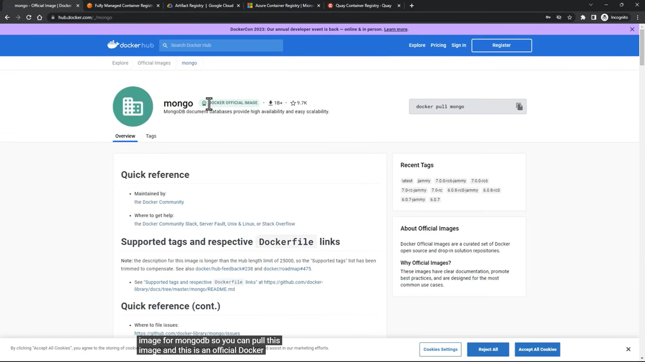
Available Docker Registry
Mongo image (https://hub.docker.com)

Slide 31
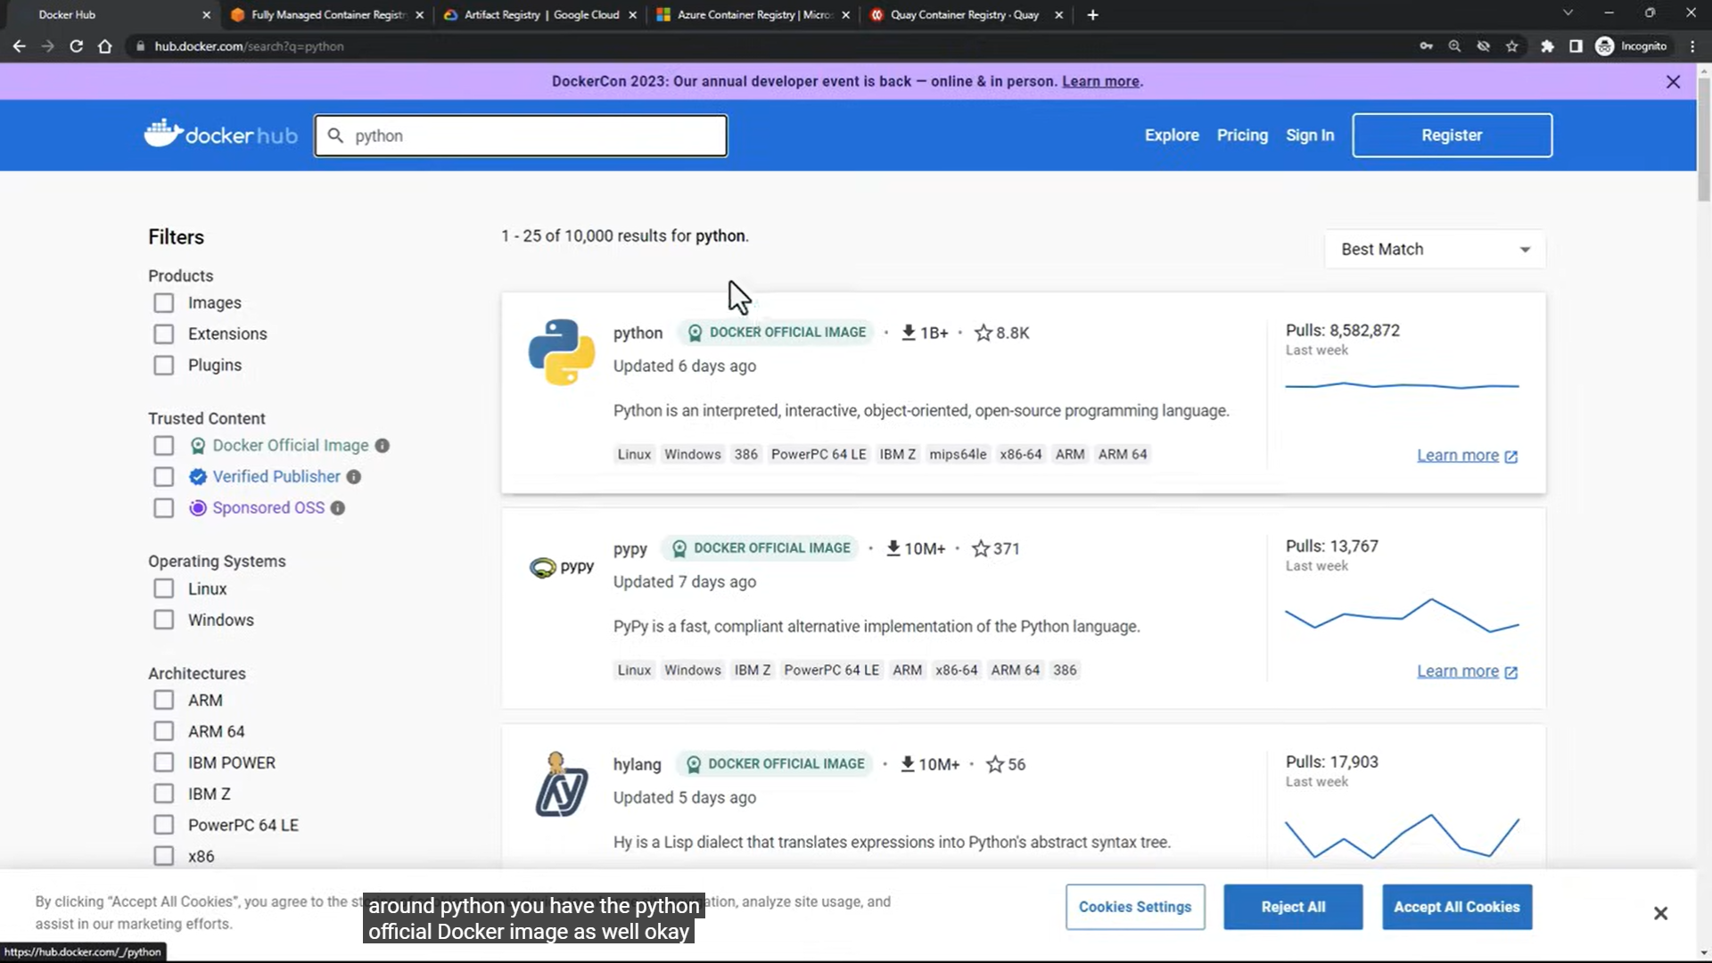
Available Docker Registry
python image (https://hub.docker.com)

Slide 32
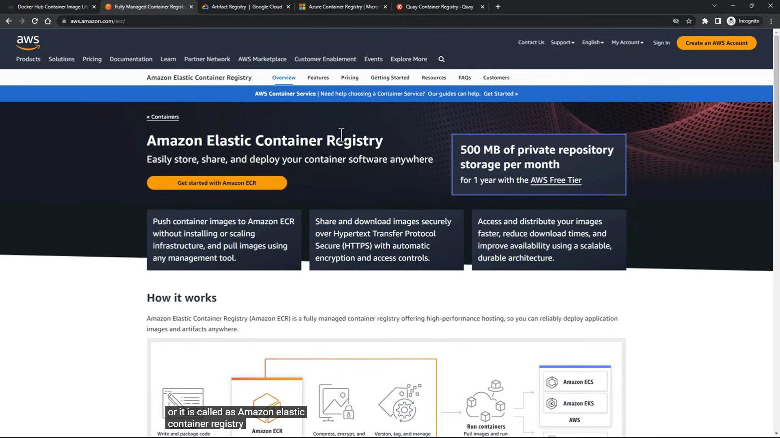
Available Docker Registry
(https://aws.amazon.com/ecr/)

Slide 33
Thank You

